Slide 1
SAP HANA on Azure Whiteboard Design Session
Presenters
Notes:
Welcome to the SAP HANA on Azure Whiteboard Design Session

Slide 2
Abstract and learning objectives
Abstract :
In this workshop, you will look at what is involved in deploying SAP HANA on Azure with the goals of designing for business continuity and flexibility as well as fully optimized total cost of ownership. At the end of this workshop, you will be able to better design, price and present SAP on Azure solutions to your customers.
Learning objectives :
Design SAP HANA workloads on Azure in alignment with SAP certification with high availability and disaster recovery.
Run Azure Pricing Calculator to price the SAP landscape.
Present the solution to business/technical decision makers and handle Q&A with customer.
Prerequisite :
R-AIT344 : Architecture deep dive for SAP deployments
R-AIT333 : SAP Migration Practitioner Panel
Understanding of SAP on Azure Webinar Training and NetWeaver on Azure reference architecture
Notes:
Present the abstract, learning objectives, and prerequisites

Slide 3
Step 1: Review the customer case study
Outcome
Analyze your customer needs.
Timeframe
10 minutes
Notes:
Inform students about the purpose of the first step of the design session

Slide 4
Customer situation : Contoso Group
Contoso Group is a pharmaceutical company with headquarters in Boston, US.
Contoso Leadership and Planning Groups wants to drastically reduce server and storage hardware in their own datacenters to minimize IT related costs. The leadership asked Contoso IT to look into the possibility to implement a greenfield S/4HANA environment in a cloud. In addition to NetWeaver-based apps, Contoso wants to evaluate the option of implementing XSA-based apps.
Since Contoso has already a number of their non-SAP systems running in Azure, Contoso IT decided to leverage its knowledge of the Microsoft cloud platform and existing ExpressRoute connectivity and host its SAP landscape in Azure as well.
Considering that Contoso finance and supply chain team will strongly rely on SAP Business Suite, the systems should be highly available and their performance must be predictable and consistent. In addition, the management team wants to leverage disaster recovery capabilities offered by Azure in order to ensure resiliency in case the primary region hosting the new deployment becomes unavailable.
Before implementing the production environment, Contoso wants to test its new deployment approach by provisioning development, and UAT environments in Azure.
Notes:
Contoso Group is a pharmaceutical company with headquarters in Boston, US.
Contoso Leadership and Planning Groups wants to drastically reduce server and storage hardware in their own datacenters to minimize IT related costs. The leadership asked Contoso IT to look into the possibility to implement a greenfield S/4HANA environment in a cloud.
Since Contoso has already a number of their non-SAP systems running in Azure, Contoso IT decided to leverage its knowledge of the Microsoft cloud platform and existing ExpressRoute connectivity and host its SAP landscape in Azure as well.
Considering that Contoso finance and supply chain team will strongly rely on SAP Business Suite, the systems should be highly available and their performance must be predictable and consistent. In addition, the management team wants to leverage disaster recovery capabilities offered by Azure in order to ensure resiliency in case the primary region hosting the new deployment becomes unavailable.
Before implementing the production environment, Contoso wants to test its new deployment approach by provisioning development, and UAT environments in Azure.

Slide 5
Contoso CIO Vision
“Our planned operational dependencies on SAP applications force us to seek reasonably priced high availability and disaster recovery capabilities for our production SAP S/4HANA deployments.”
Andrew Cross, CIO, Contoso Group
Notes:
The CIO, Andrew Cross stated “Our planned operational dependencies on SAP applications force us to seek reasonably priced high availability and disaster recovery capabilities for our production SAP S/4HANA deployments.”

Slide 6
Contoso S/4HANA requirements
 | HANA DB RAM requirement | Application SAPS requirement (SAPS) | High Availability for DB, application and file-share | Disaster Recovery for DB, application and file-share) | DB backup and retention period
Production | 2TiB | 15,000 | Required (No data loss, 99.95%+ VM uptime) | Required | Log backup every 30min retained for 1 day, Full daily backup for 1 month
Quality Assurance | 2TiB | 15,000 | Required (Same as Prod) | No | Full bi-weekly backup for 1 month
Development | 192GiB | No | No | No | Full bi-weekly backup for 1 month
Notes:
(*) SAPS : SAP Application Performance Standard (SAPS) is a hardware-independent unit of measurement that describes the performance of a system configuration in the SAP environment. It is derived from the Sales and Distribution (SD) benchmark, where 100 SAPS is defined as 2,000 fully business processed order line items per hour.
According to the estimates of the Contoso IT team, the database is bound to grow to about 2TB in the next few years.
1. Contoso S/4HANA requirements:
Target environment:
- Sizing
- Production
- HANA DB memory requirement; 2 TiB
- Application SAPS requirements (SAPS): 15,000
- Quality Assurance
- HANA DB memory requirement; 2 TiB
- Application SAPS requirements (SAPS): 15,000
- Development
- HANA DB memory requirement; 192 GiB
- Application SAPS requirements (SAPS): none
2. Business continuity
- High Availability and Disaster Recovery
- Each proposed solution must include both high availability and disaster recovery capabilities for the Production environment (99.95% uptime)
- Each proposed solution must include high availability for the Quality Assurance environment (99.95% uptime)
- The disaster recovery solution must ensure business continuity in case of an event affecting the entire Azure datacenter hosting the Production environment
- Data protection
- No data loss allowed in the Production and the Quality Assurance environment
- Production
- HANA DB log backup taken every 30 minutes and retained for 1 day
- HANA DB full backup every night and retained for 1 month
- Quality Assurance
- HANA DB full bi-weekly backup retained for 1 month
- Development
- HANA DB full bi-weekly backup retained for 1 month

Slide 7
Customer objections
Is the proposed solution fully certified by SAP?
Does the proposal meet Contoso business continuity requirements? What if there's outage on VM or storage? How can we restore from backup? How can we failover the landscape in case of an outage?
There're legacy systems on-prem that needs to interact with S/4HANA in cloud. How can we minimize performance impact in cross-premises scenarios?
Can we change the size of the environment if sizing requirements change in future?
Is there anything not included in the results of Azure Pricing Calculator?
CFO is asking for cost saving even further. What can we do to optimize the cost? What are our options?
Notes:
Customer raised some concerns and objections:
Is the proposed solution fully certified by SAP?
Does the proposal meet Contoso business continuity requirements? What if there's outage on VM or storage? How can we restore from backup? How can we failover the landscape in case of an outage?
There're legacy systems on-prem that needs to interact with S/4HANA in cloud. How can we minimize performance impact in cross-premises scenarios?
Can we change the size of the environment if sizing requirements change in future?
Is there anything not included in the results of Azure Pricing Calculator?
CFO is asking for cost saving even further. What can we do to optimize the cost? What are our options?

Slide 8
Discuss key design considerations
Key design components:
HANA System Replication
Windows/Linux clusters
Windows SOFS or Linux DRBD or Azure NetApp Files
Azure Site Recovery
VNet Hub & Spoke topology
Two primary HA/DR options
HA in an Availability Set and DR across regions (DR replica can coexist with QA in the second region)
HA/DR across Availability Zones
Notes:
Present the key design considerations applicable to this design

Slide 9
Infrastructure considerations
Networking considerations
ExpressRoute for end user access with geo-redundancy provisions
Site-to-Site VPN for remote administration and monitoring
Additional infrastructure considerations
Blob storage for backup retention
Jump-box
DNS
Patching
Backup
Monitoring
Cluster arbitration (Cloud Witness and SBD)
Proximity placement groups
Notes:
Present the infrastructure considerations applicable to this design

Slide 10
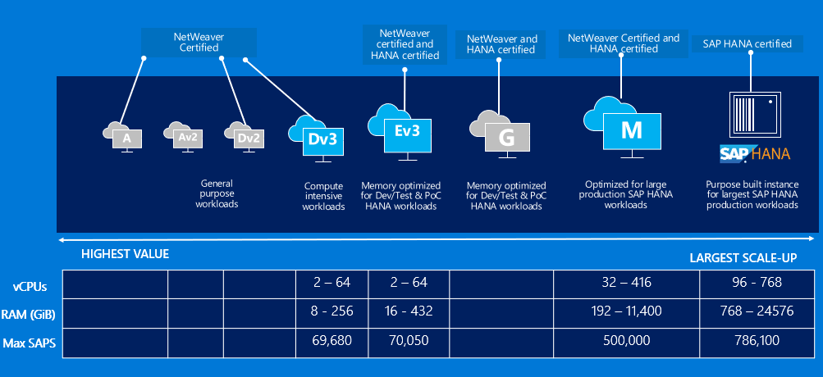
SAP on Azure – A wide variety of Compute instances
Notes:
When implementing SAP HANA-based workloads in Azure, you have the choice of deploying HANA on Azure virtual machines or bare-metal, purpose-built hardware referred to as SAP HANA on Azure (Large Instances).
There is a growing number of Azure VM SKUs certified for hosting SAP HANA including GS5 and a number of M family VM sizes (with M208ms_v2, featuring 5.7 TiB of memory and with M128s supporting scale-out configuration). There is also much larger selection of Azure VM SKUs that support non-HANA workloads (NetWeaver and non-NetWeaver products).
SAP HANA on Azure (Large Instances) involves deploying and running SAP HANA without the use of a hypervisor, with each physical server dedicated to an individual customers. The server hardware is part of a larger stamp that contain networking, compute, and storage infrastructure. Each stamp is associated with a tenant. A tenant is assigned to a single customer. A customer can have multiple tenants. SAP HANA on Azure (Large Instances) represents an example of HANA tailored data center integration (TDI) certified deployment methodology. Customers can choose from several server SKUs, ranging from 36 Intel CPU cores and 768 GB of memory to 480 Intel CPU cores and 24 TB (up to 120-TB in the scale-out configuration) of memory. Two different classes of hardware divide the SKUs into:
S72, S72m, S96, S144, S144m, S192, S192m, and S192xm, which are referred to as the "Type I class" of SKUs.
S384, S384m, S384xm, S384xxm, S576m, S576xm S768m, S768xm and S960m, which are referred to as the "Type II class" of SKUs.

Slide 11
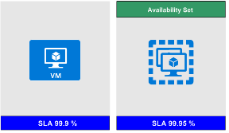
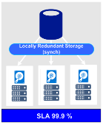
SAP VM & Storage Sizing Principles
Know # of SAPS for SAP application and database tiers
Know system activity period, use snoozing, Azure automation to shutdown (i.e. sandbox 10x5, not 24x7)
For SAP App servers, use a few smaller VM vs one large VM (redundant nodes).
Ensure the selected VM supports the IOPS & throughput requirements of the database server.
Choose standard or premium storage Managed Disks based on IOPS and disk throughput requirements.
Use premium storage for SAP databases for both database and log files.
For database servers use LINUX-LVM to stripe disks and aggregate IOPS, throughput and storage capacity
For non-business critical environments, SAP App servers can be deployed on small premium storage (P4, P6) if using a single server in order to benefit from single instance SLA.
Notes:
Sizing of SAP VM compute and storage resources should be based on the following criteria:
Compute
Identify the number of SAPS for SAP application and database tiers
Identify system activity period, use snoozing and Azure automation to shutdown during idle times (i.e. run sandbox 10x5, not 24x7)
For SAP application servers, use a few smaller VM vs one large VM (to provide redundancy)
Storage
Ensure the selected VM support the IOPS & throughput requirements of the database server.
Choose Standard or Premium storage Managed Disks based on IOPS and disk throughput requirements.
Use Premium storage for SAP databases (both database files and log files).
For database servers use Windows storage spaces or LINUX-LVM to stripe (glue) disks and aggregate IOPS, throughput and storage capacity
For non-production environments, SAP App servers can be deployed on small premium storage (P4, P6) if using a single server in order to benefit from single instance SLA.

Slide 12
Pick Azure Compute for HANA and Application Servers
Choose right Azure Compute based on :
Scenario (OLTP or OLAP)
OLTP : S/4HANA, Business Suite on HANA, NetWeaver
OLAP : BW on HANA, BW/4HANA, Enterprise DWH, Sidecar
Required RAM for HANA and SAPS for application servers
 | Prod or Non-Prod | HANA scenario | HANA DB/RAM size | Select Compute based on RAM size required for HANA server(s) | Select Compute based on SAPS required for SAP application servers
1 | Dev and Test | OLTP, OLAP | - | E v3 or M Series VM | D v3 Series VM – scale out
2 | Production | OLTP | 192GiB to 11.4TiB | M Series VM - scale up
3 | Production | OLAP | 192GiB to 6TiB | M Series VM – scale up
4 | Production | OLTP | 6 to 24TiB | HANA Large Instances – scale up
5 | Production | OLAP | 3 to 4TiB | HANA Large Instances – scale up
6 | Production | OLAP | 4 to 60TiB | HANA Large Instances – multiple nodes (scale out up to 16 nodes)
Notes:
Sizing of HANA and application servers should be based on the two primary set of criteria:
The intended workload: OLTP (S/4HANA, Business Suite on HANA, and NetWeaver) or OLAP (BW on HANA, BW/4HANA, Enterprise DWH, Sidecar).
Memory (HANA) and SAPS (application servers)
Environment (production or non-production)
Architecture (scale-up or scale-out)

Slide 13
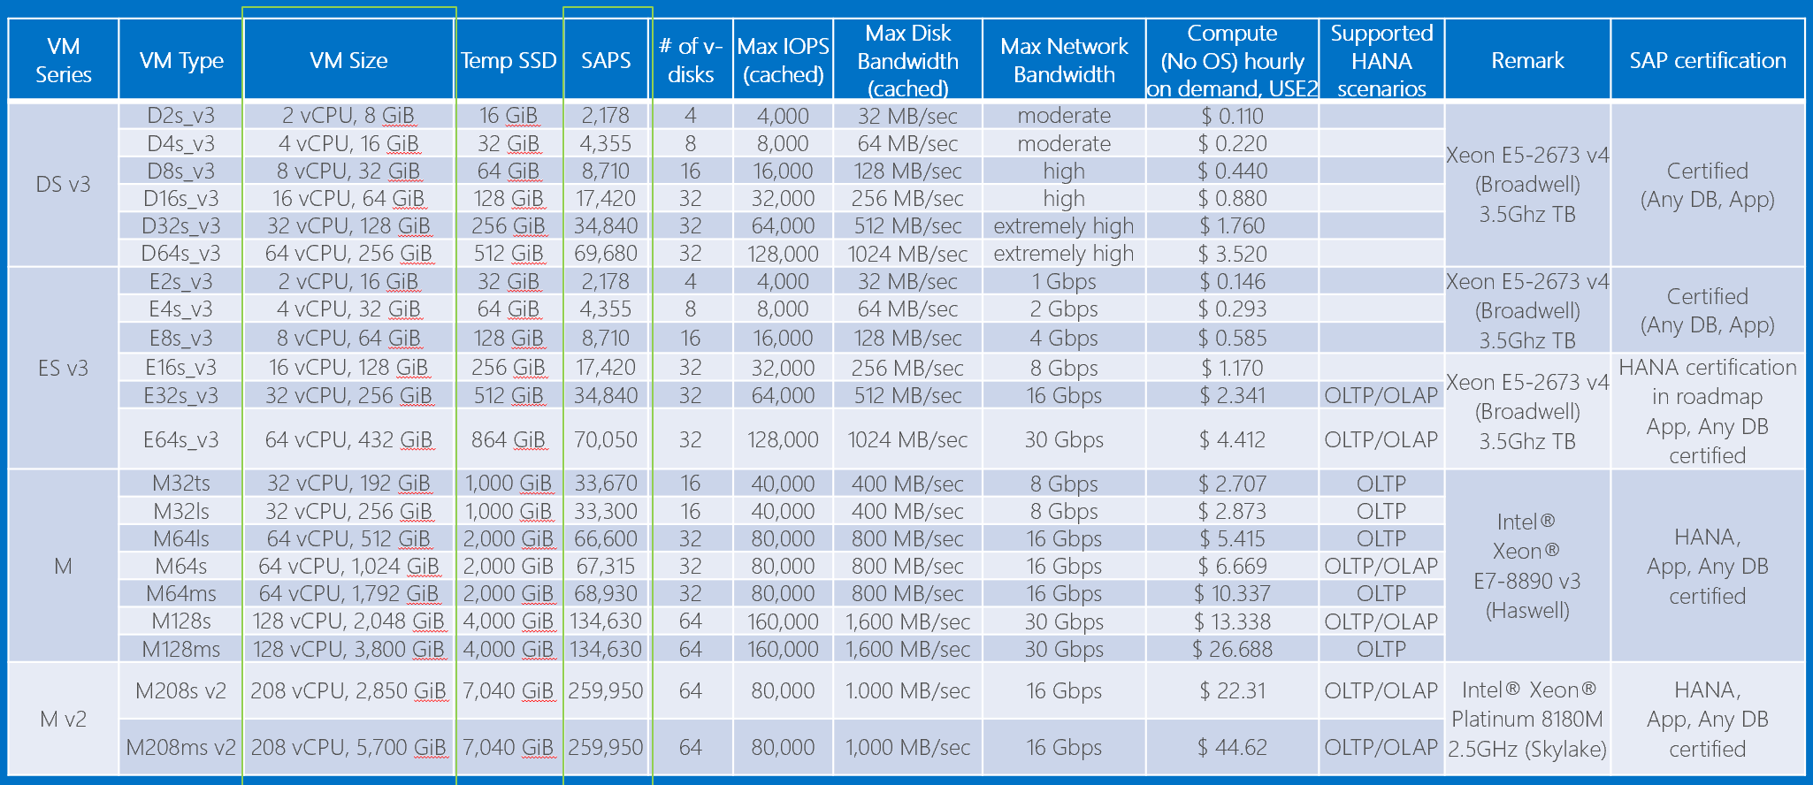
Choose Azure VM types to meet sizing requirements
SAP Note 1928533 and https://docs.microsoft.com/en-us/azure/virtual-machines/windows/sizes-memory
Notes:
Review performance characteristics referenced in the table on the current slide. Point out that some of the VM types are on the certification roadmap for SAP HANA. Explain that, in order to implement SAP workloads on Azure in a supported manner, customers should following SAP certified configurations, which consist of a combination of the following four elements:
- SAP product
- Operating system
- RDBMS
- Azure offering, including Azure VM SKU and (in case of HANA) SAP HANA on Azure (Large Instances)
For additional information, refer to SAP Note #1928533 - SAP Applications on Azure: Supported Products and Azure VM types

Slide 14
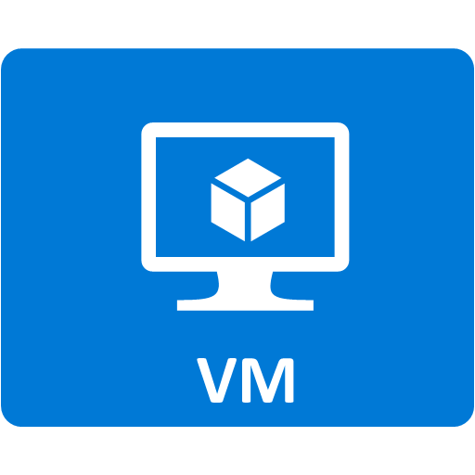
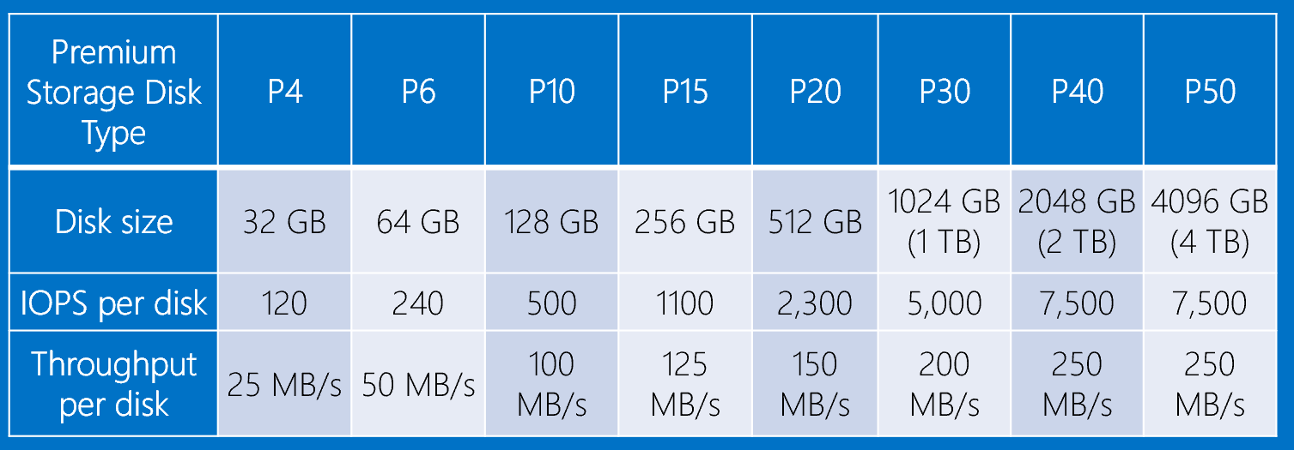
Premium Storage KPIs (Cost differ by region)
Consistent low latency SSD with predictable throughput
For high-performance IO-intensive DB workloads
Single digit ms latencies
Supports up to 32 TB blob/disk size
Stripe up to 64 disks for a total of 2,048 TB
Disk performance is dependent on the disk size, with up to 7,500 IOPS per disk
Pay for what you provision
Check Azure VMs for maximum IOPS
* Stripe Premium Storage Disks to aggregate
IOPS, Throughput and Storage Capacity
Notes:
Consistent low latency SSD with predictable throughput
Intended for high-performance IO-intensive DB workloads
Single digit ms latencies
Supports up to 32 TB blob/disk size
Stripe (to aggregate IOPS, throughput, and capacity) up to 64 disks for a total of 2,048 TB
Disk performance is dependent on the disk size, with up to 20,000 IOPS per disk
Ensure to account for Azure VMs level IOPS limits
Pay for what you provision (cost per GB differs by region)

Slide 15
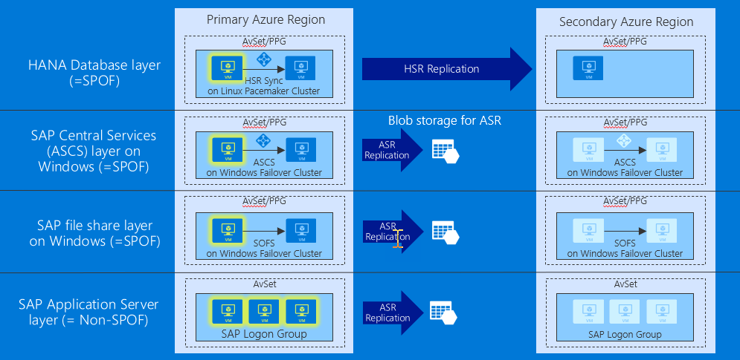
SAP HA in availability sets and DR across regions
Notes:
The current slide represents the traditional design, which relies on well-established concept of availability sets and leverages a pair of Azure regions in the same geography. An Azure Availability Set is a logical grouping capability that helps ensure that the VM resources that you place within the Availability Set are failure-isolated from each other when they are deployed within an Azure datacenter. Azure ensures that the VMs you place within an Availability Set run across multiple physical servers, compute racks, storage units, and network switches. This configuration is referred to as placements in different update and fault domains. These placements usually are within an Azure datacenter. Assuming that power source and network issues would affect the datacenter that you are deploying, all your capacity in one Azure region would be affected. To further optimize this design, you should consider leveraging placement proximity groups, whenever the latency of communication between Azure VMs in the same availability set should be minimized.
Note that it is important to consider high availability and disaster recovery provisions separately for each component of this design:
- HANA Database layer - both high availability and disaster recovery is implemented by using HANA System Replication (synchronous or asynchronous, depending on the option). In case of synchronous replication, the high availability functionality relies additionally on Linux-based Pacemaker clustering.
- SAP Central Services (ASCS) layer - high availability is implemented by using operating system-level clustering (either Windows Server Failover Clustering or Linux-based Pacemaker clustering, depending on the underlying operating system). Disaster recovery across Azure regions relies on Azure Site Recovery, which replicates virtual disks of cluster members to the secondary site. Azure Site Recovery is also used to orchestrate failover between sites.
- SAP file share layer - high availability of the sapmnt share is implemented by using either Windows-based file share (based on Windows Storage Spaces Direct cluster hosting Scale-Out File Server) or Linux-based NFS mount (based on Azure NetApp Files or Linux Distributed Replicated Block Device). Disaster recovery relies on Azure Site Recovery, which replicates the file sharing infrastructure to the secondary site. When using Azure NetApp Files NFS-based approach, NetApp offers a SaaS based solution called NetApp Cloud Sync. You can use any file based-copy tool (such as rsync) to replicate data to the secondary site (including file or folder permissions). To replicate an Azure NetApp Files volume to another Azure region, you need to connect their respective virtual networks. You can use for this purpose global peering.
- SAP Application Server layer - high availability is implemented by simply deploying multiple application servers. Disaster recovery across Azure regions relies on Azure Site Recovery, which replicates virtual disks of application servers to the secondary site. Azure Site Recovery is also used to orchestrate failover between sites.

Slide 16
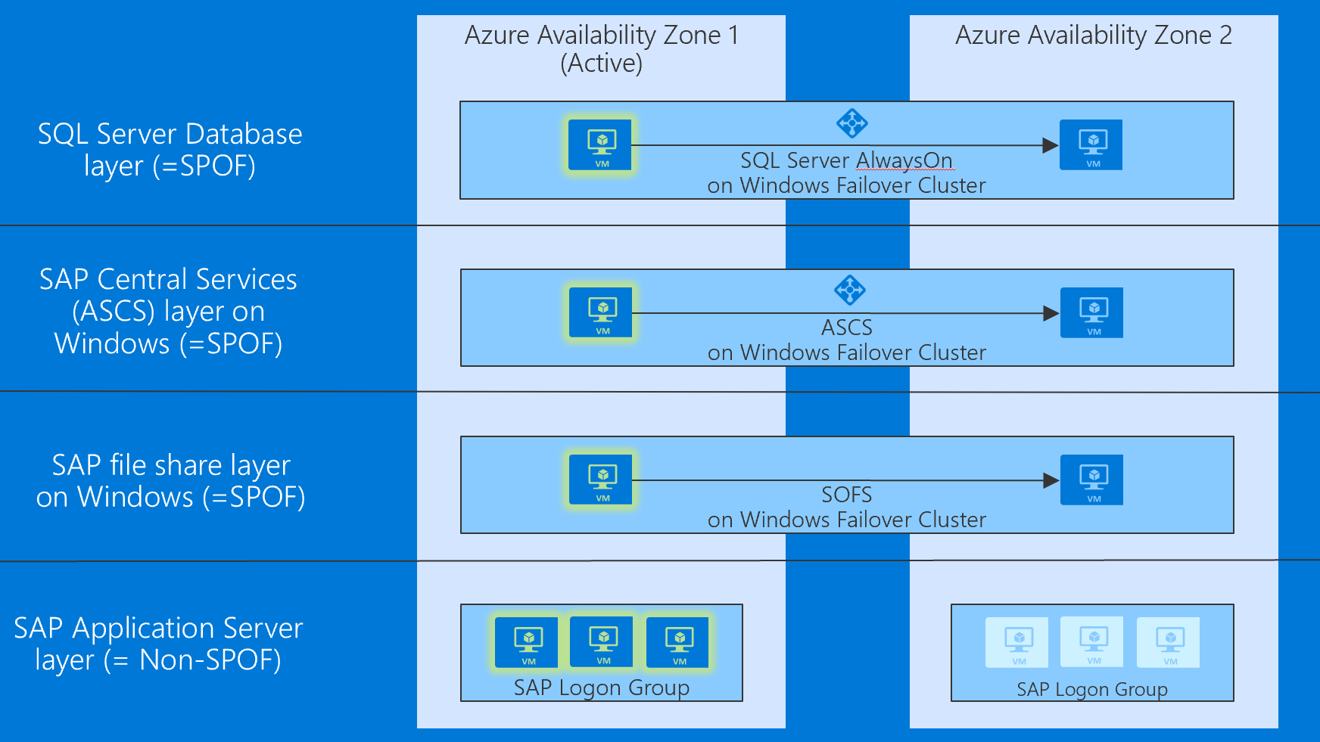
S/4HANA HA and DR across Availability Zones
Notes:
The current slide represents a different design that takes advantage of availability zones, representing separate, physically isolated data centers within the same region. The placement of datacenters that represent Azure Availability Zones constitutes a compromise between delivering acceptable network latency to services deployed in different zones, and a distance between datacenters. The distance matters because even though majority of destructive events are not likely to affect the infrastructure of all Availability Zones in the same region, history offers examples of larger scale disasters that could have such impact. To account for such occurrences, organizations might have the minimum distance requirement between the location of their production and disaster recovery sites. For most Azure customers, the minimum distance definition necessitates the use of two or more Azure regions.
Note that it is important to consider high availability and disaster recovery provisions separately for each component of this design. In this case, the highly available production components are distributed across Availability Zone 1 and Availability Zone 2:
- HANA Database layer is hosted by a Linux Pacemaker cluster containing an active VM instance residing in Availability Zone 1 and standby VM instance residing in Availability Zone 2, with HANA Synchronous replication between nodes of the cluster. Clustering is implemented by using Pacemaker.
- ASCS layer hosted by a Windows cluster contains an active VM instance residing in Availability Zone 1 and a standby VM instance residing in Availability Zone 2.
- SAP file share layer on Windows cluster contains an one VM node residing in Availability Zone 1 and another VM node residing in Availability Zone 2.
- SAP Application Server layer consists of a PAS server VM in Availability Zone 1 and AAS in Availability Zone 2. Clustering is not used in this case since high availability is built-into the PAS and AAS functionality.

Slide 17
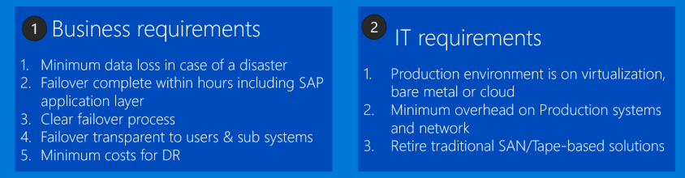
Disaster Recovery Solutions for LOB applications/SAP on Azure
Database Replication (e.g. HSR)
File Replication (e.g. File Copy)
VM Replication (Azure Site Recovery)
Notes:
Requirements can be divided into two categories:
1. Business requirements:
- Minimum data loss in case of a disaster
- Failover completed within hours (including SAP application layer)
- Clear failover process
- Failover process is abstracted from users and subsystems
- Minimum cost
2. IT requirements:
- Production environment is virtualized, on bare metal, or in the cloud
- Minimum overhead on production environment (including networking)
- No need for traditional SAN/tape backup solutions
Recommended solution consist of three primary components:
Database replication (e.g. HANA System Replication)
File replication (e.g. file copy)
VM replication (Azure Site Recovery)

Slide 18
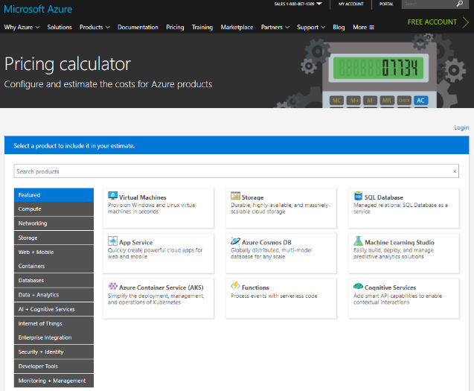
Online Azure pricing calculator
https://azure.microsoft.com/en-us/pricing/calculator/
Notes:
Demonstrate the use of Azure Pricing Calculator as you present this slide.

Slide 19
Step 2: Design and price the solution
Outcome
Design a solution and prepare to present the solution to the target customer audience in a 15-minute chalk-talk format.
Timeframe
50 minutes
Business needs (10 minutes) | Respond to questions outlined in your guide and list the answers on a flipchart
Design (30 minutes) | Design a solution for as many of the stated requirements as time allows. Show the solution on a flipchart
Prepare (10 minutes) | Identify any customer needs that are not addressed with the proposed solution Identify the benefits of your solution Determine how you will respond to the customer’s objections Prepare for a 15-minute presentation to the customer
Notes:
Inform students about the purpose of the second step of the design session

Slide 20
Step 3: Present the solution
Outcome
Present a solution to the target customer in a 15-minute chalk-talk format.
Timeframe
30 minutes (15 minutes for each team to present and receive feedback)
Directions
Pair with another table.
One table is the Microsoft team and the other table is the customer.
The Microsoft team presents their proposed solution to the customer.
The customer asks one of the objections from the list of objections in the case study.
The Microsoft team responds to the objection.
The customer team gives feedback to the Microsoft team.
Notes:
Inform students about the purpose of the third step of the design session

Slide 21
Wrap-up
Outcome
Identify the preferred solution for the case study.
Identify solutions designed by other teams.
Timeframe
20 minutes
Notes:
Keep track of time and coordinate students’ activities

Slide 22
Preferred target audience
Business Development Manager (BDM) or Application Sponsor (CFO)
Funds projects and apps
Most interested in public cloud
Business Unit IT / Developers (Director of SAP Business Analysts, Director of SAP Operations)
Reports to BDM and is responsible for coding and testing apps
Big influencer of public cloud strategy
Central IT (VP of IT Operations)
Reports into CIO and responsible for operating datacenter
Concerned about shadow IT created issues: security/compliance, server sprawl, and lack of control
Notes:
The target audience should consist of:
Business Development Manager (BDM) or Application Sponsor (CFO)
Funds projects & apps
Most interested in public cloud
Business Unit IT / Developers (Director of SAP Business Analysts, Director of SAP Operations)
Reports to BDM and is responsible for coding and testing apps
Big influencer of public cloud strategy
Central IT (VP of IT Operations)
Reports into CIO and responsible for operating datacenter
Concerned about shadow IT created issues: security/compliance, server sprawl, and lack of control

Slide 23
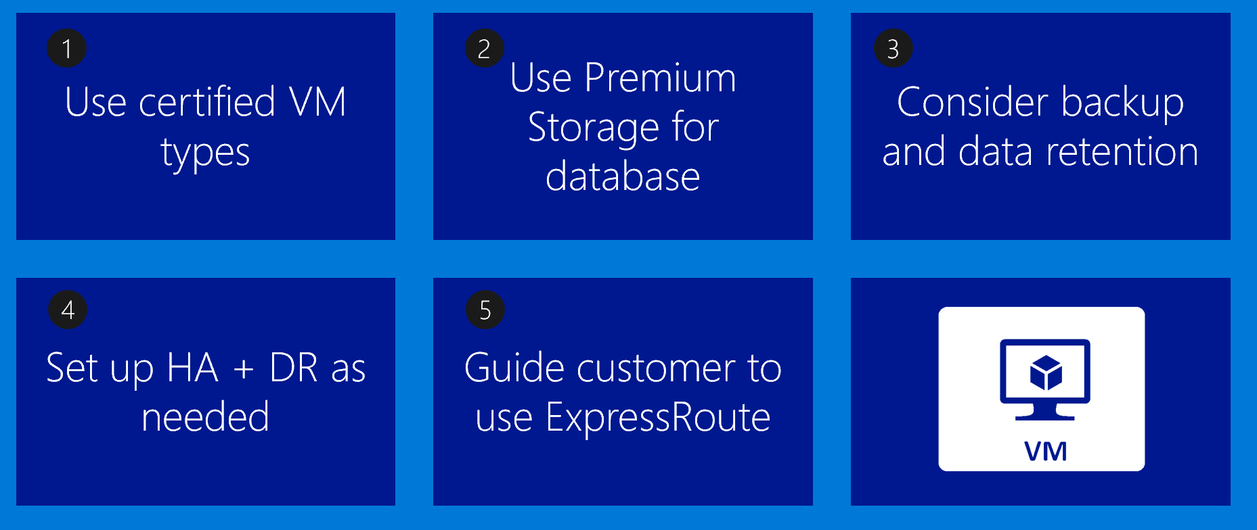
Azure VM Design Tips
Notes:
Reference this slide when describing both options of the preferred solution

Slide 24
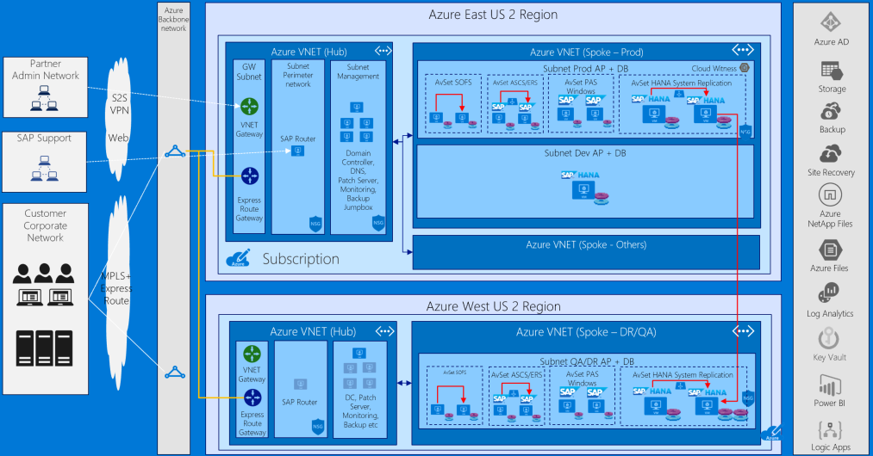
S/4HANA: HA (in availability sets) and DR (across regions)
Notes:
The first option (Azure VMs – HA in Availability Set and DR across Regions) represents the traditional design, which relies on well-established concept of availability sets and leverages a pair of Azure regions in the same geography. An Azure Availability Set is a logical grouping capability that helps ensure that the VM resources that you place within the Availability Set are failure-isolated from each other when they are deployed within an Azure datacenter. Azure ensures that the VMs you place within an Availability Set run across multiple physical servers, compute racks, storage units, and network switches. This configuration is referred to as placements in different update and fault domains. These placements usually are within an Azure datacenter. Assuming that power source and network issues would affect the datacenter that you are deploying, all your capacity in one Azure region would be affected.

Slide 25
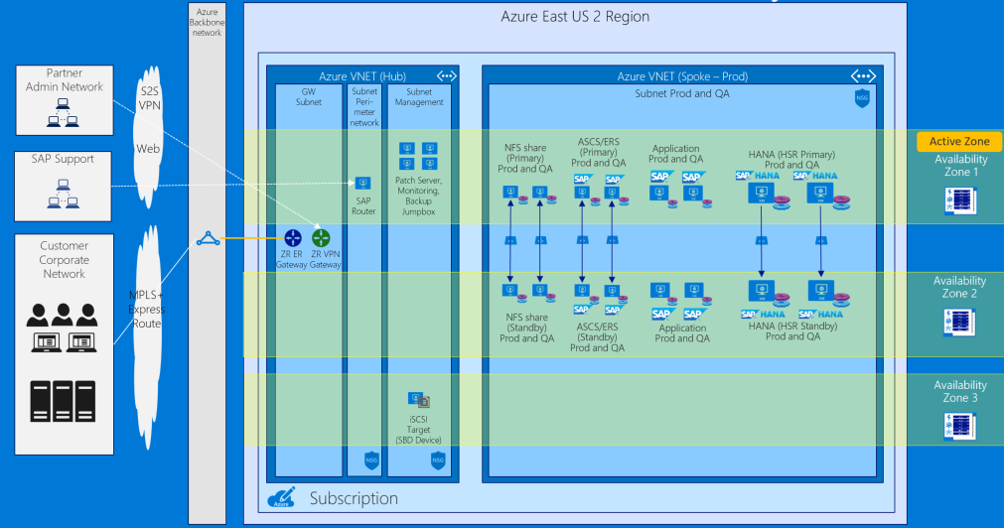
S/4HANA: HA and DR (across availability zones)
Notes:
The second option (Azure VMs - HA and DR across Availability Zones) takes advantage of the availability zones, representing separate, physically isolated data centers within the same region. The placement of datacenters that represent Azure Availability Zones constitutes a compromise between delivering acceptable network latency to services deployed in different zones, and a distance between datacenters. The distance matters because even though majority of destructive events are not likely to affect the infrastructure of all Availability Zones in the same region, history offers examples of larger scale disasters that could have such impact. To account for such occurrences, organizations might have the minimum distance requirement between the location of their production and disaster recovery sites. For most Azure customers, the minimum distance definition necessitates the use of two or more Azure regions.

Slide 26
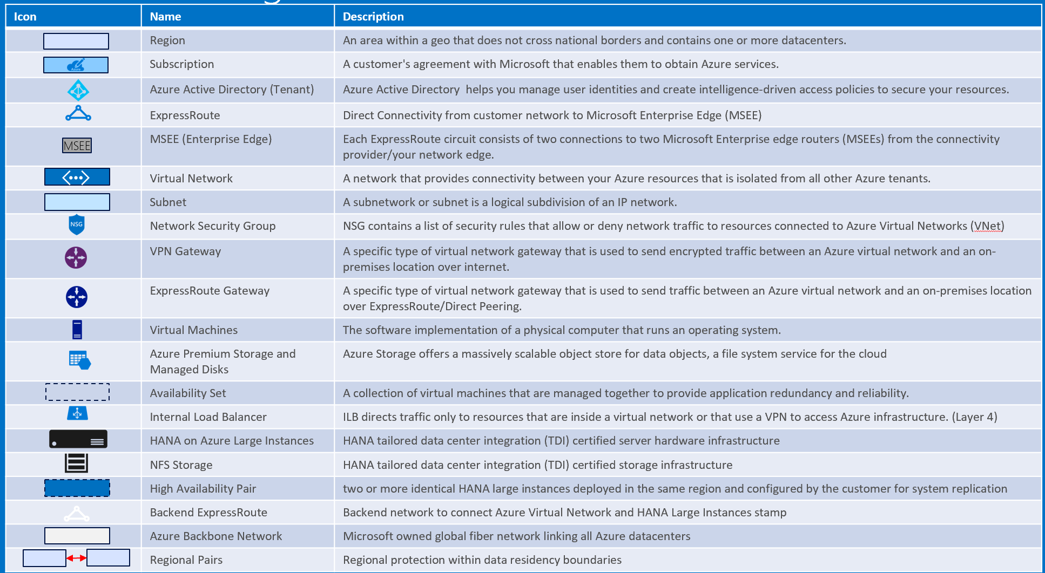
Baseline knowledge for SAP as a service on Azure
Notes:
Reference this slide when describing both options of the preferred solution.

Slide 27
S/4HANA on Azure: T-Shirt Pricing
# | S/4HANA DB Size | Cost Conscious or HA/DR | Estimated monthly Azure cost (USD)
1 | 192GB | Cost Conscious | $5,568.48
2 | 256GB | Cost Conscious | $5,746.62
3 | 512GB | Cost Conscious | $7,630.41
4 | 1TB | Cost Conscious | $9,631.73
5 | 1.75TB | Cost Conscious | $11,551.01
6 | 2TB | Cost Conscious | $12,051.57
7 | 3TB | Cost Conscious | $17,971.85
8 | 4TB | Cost Conscious | $20,978.26
9 | 6TB | Cost Conscious | $29,892.95
10 | 192GB | HA/DR | $10,131.37
11 | 256GB | HA/DR | $10,266.94
12 | 512GB | HA/DR | $12,588.07
13 | 1TB | HA/DR | $15,739.16
14 | 1.75TB | HA/DR | $22,267.93
15 | 2TB | HA/DR | $24,006.33
16 | 3TB | HA/DR | $36,150.50
17 | 4TB | HA/DR | $41,375.19
18 | 6TB | HA/DR | $58,892.93
Notes:
The pricing consists of two main categories: *HA/DR* and *cost conscious* (without HA/DR). Each quote includes cost of Production, QA, and Development environments, as well as it takes into account compute, storage, networking, SUSE OS/support, Azure Professional Direct Support (which is, at minimum, required when deploying SAP production solutions in Azure). The *cost conscious* pricing doesn’t include HA nor DR (single VM) and assumes retention of daily backups of Production for one month, along with biweekly QA and Dev backups. The *HA/DR* option includes Standard Load Balancer in the primary site and a DR replica in the secondary site, with retention of daily backups of Production for one month, monthly and quarterly for one year, along with monthly backups of QA and Dev monthly retained for one year.
Note :
All options include Prod, QA, Dev, Storage, Management, Network, SUSE OS/support, Azure Professional Direct Support and full SAP certification
All options does NOT include software licenses of SAP, Backup, Monitoring and Windows OS (because of AHUB)
Cost conscious doesn’t include HA nor DR (single VM) | backup retention : PRD daily for one month (= x 31), QA and Dev twice per month (= x 2)
HA/DR include local HA in Availability Set with Standard Load Balancer and DR replica in another region | backup retention PRD daily for one month, monthly and quarterly for one year (= x 47), QA and Dev monthly for one year (= x 12)

Slide 28
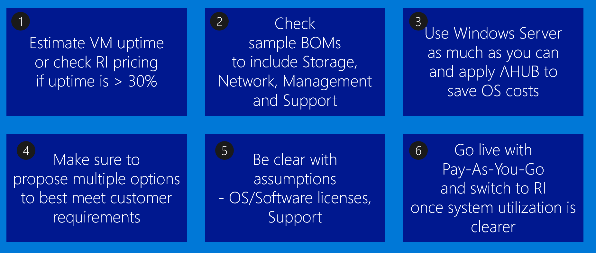
Azure VM Pricing Tips
Notes:
VM uptime is a critical input for Compute Cost.
Consider using Reserved Instances for VMs that need to be online 24 x 7
When using Windows Server VMs, take advantage of the Azure Hybrid Use Benefits (if applicable)
Propose multiple options to customers, depending on their resiliency requirements
Make sure to account for SAP licenses, OS licenses, and Microsoft Support
Start with Pay-As-You-Go licensing and switch to Reserved Instances once expected system utilization is determined

Slide 29
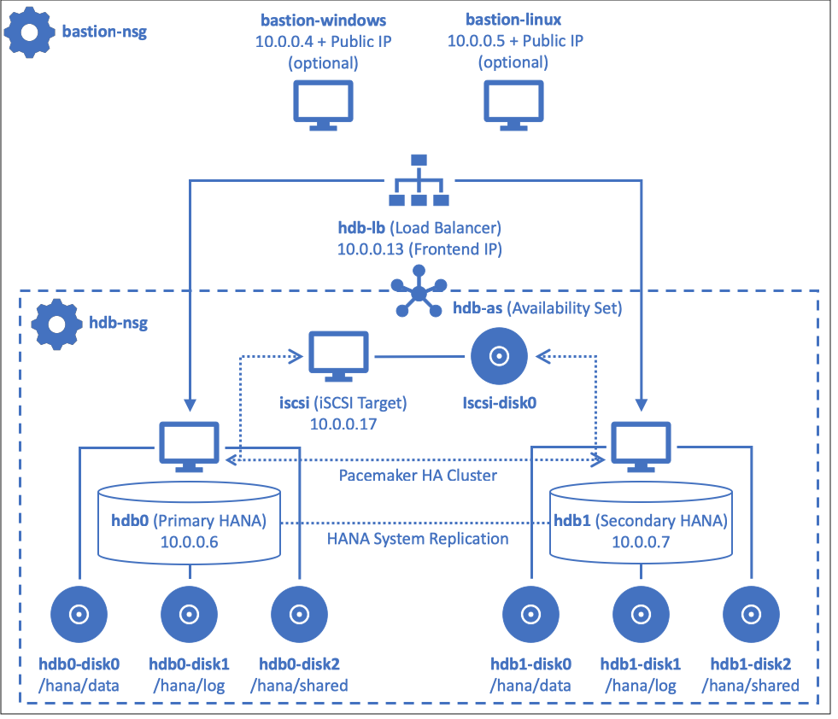
Automated HANA deployment with Terraform and Ansible Step-by-step Hands-on Lab guidance can be found on GitHub
Notes:
Considering technologies used or intended to be used for on-premises deployments, the solution will leverage Ansible for configuration management and Terraform for Azure resource provisioning. The solution offers full automation capabilities, including both provisioning Azure resources, as well as installation and configuration of SAP HANA software components.

Slide 30
Preferred objections handling
Is the proposed solution fully certified by SAP?
Each of the T-Shirt pricing options represents a fully SAP-certified configuration. For more information, refer to https://docs.microsoft.com/en-us/azure/virtual-machines/workloads/sap/hana-available-skus

Slide 31
Preferred objections handling #1
Does the proposal meet Contoso business continuity requirements? What if there's outage on VM or storage? How can we restore from backup? How can we failover the landscape in case of an outage?
Both proposed options facilitate HA and, depending on the scope, an accidental outage affecting either the entire Azure region (option 1) or an individual Azure datacenter (corresponding to the Availability Zone hosting the production environment). With option 1, the failover between regions is manual because there is a potential for data loss due to asynchronous replication of HANA between the production and disaster recovery site. Such failover can be streamlined by leveraging Azure Site Recovery. With option 2, this failover can be automated since HANA replication is synchronous.
Notes:
Both proposed options facilitate HA and, depending on the scope, an accidental outage affecting either the entire Azure region (option 1) or an individual Azure datacenter (corresponding to the Availability Zone hosting the production environment). With option 1, the failover between regions is manual because there is a potential for data loss due to asynchronous replication of HANA between the production and disaster recovery site. Such failover can be streamlined by leveraging Azure Site Recovery. With option 2, this failover can be automated since HANA replication is synchronous.
VMs hosting SAP Application can be backed up using Azure Backup. For VM-level recovery, you might consider using Azure VM Backup. Azure Backup stores the backups in Azure and allows a restore of a VM again. However, be aware that Azure VM backup supports only a single scheduled backup per day. In addition, note that using VM Backup does not preserve the unique VM ID which is used for SAP licensing. This means that a restore from a VM backup requires installation of a new SAP license key as the restored VM is considered to be a new VM and not a replacement of the former one which was saved.
SAP HANA on Azure VMs can be backed up by using the following two methods:
o HANA backup to the file system in an Azure Linux Virtual Machine
o HANA backup based on storage snapshots using the Azure storage blob snapshot feature manually or Azure Backup Service
A common backup scheduling strategy described in the HANA Administration guide involves the following backups:
o Storage snapshot (daily)
o Complete data backup using file or bacint format (once a week)
o Automatic log backups
Optionally, one could go completely without storage snapshots; they could be replaced by HANA delta backups, like incremental or differential backups. The HANA Administration guide provides an example list. It suggests that one recover SAP HANA to a specific point in time using the following sequence of backups:
o Full data backup
o Differential backup
o Incremental backup 1
o Incremental backup 2
o Log backups
Regarding an exact schedule as to when and how often a specific backup type should happen, it is not possible to give a general guideline—this would be customer-specific and dependent on the volume of data changes in the system. One basic recommendation from SAP side, which can be seen as general guidance, is to make one full HANA backup once a week. SAP also recommends doing some housekeeping of the backup catalog to keep it from growing infinitely.

Slide 32
Preferred objections handling #2
There're legacy on-prem systems that need to interact with S/4HANA in cloud. How can we minimize performance impact in cross-premises scenarios?
ExpressRoute provides secure, high-bandwidth, low-latency connectivity between Azure and on-premises datacenters. ExpressRoute provides more predictable performance, with higher bandwidth and lower latency than VPN connections. ExpressRoute offers per-circuit throughput of up to 10 gigabits per second (Gbps), with the per-gateway throughput of up to 9000 megabits per second (Mbps). These capabilities make ExpressRoute the preferred choice for enterprise and mission-critical workloads.

Slide 33
Preferred objections handling #3
Can we change the size of the environment if sizing requirements change in future?
Azure VMs can be resized on demand (changing a VM size requires a reboot). If a non-production Azure VM is not being used frequently, you can resize it down to a smaller size to reduce your monthly costs. If an Azure VM is reaching its performance limits, it can be resized to a larger size to increase its capacity.

Slide 34
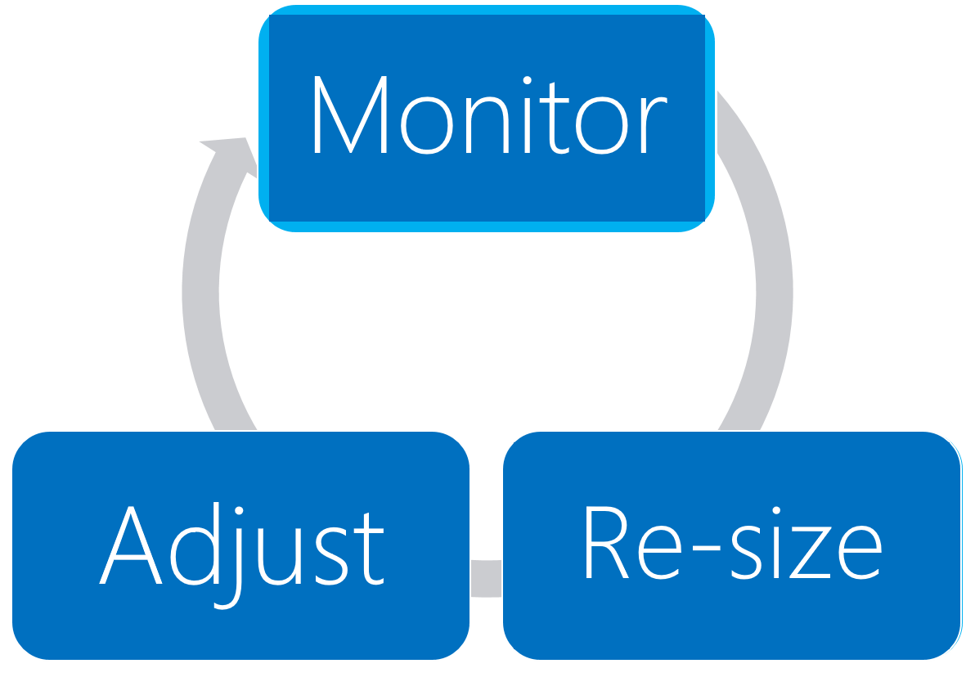
Process to optimize SAP landscape
Notes:
The solution sizing is a continuous process that involve monitoring, re-sizing, and adjusting. Fortunately, resizing Azure VMs is a straightforward process.

Slide 35
Preferred objections handling #4
Is there anything not included in the results of Azure Pricing Calculator?
The T-Shirt pricing does not include SAP software licensing, cost of monitoring/logging, as well as Windows Server licensing costs (the pricing assumes that Contoso will be able to leverage Azure Hybrid Use Benefit)

Slide 36
Preferred objections handling #5
CFO is asking for cost saving even further. What can we do to optimize the cost? What are our options?
Estimate VM uptime and use Reserved Instances if uptime is larger than 30%
Review T-Shirt pricing model
When using Windows Server, take advantage of the Azure Hybrid Use Benefits (AHUB)
Schedule stopping and deallocating of non-production virtual machines during their idle times
Notes:
- Estimate VM uptime and use Reserved Instances if uptime is larger than 30%
- Review T-Shirt pricing model
- When using Windows Server, take advantage of the Azure Hybrid Use Benefits (AHUB)
- Schedule stopping and deallocating of non-production virtual machines during their idle times:
This functionality is available directly from the Azure portal. Alternatively, you can use Azure Automation runbooks or custom Azure PowerShell and Azure CLI scripts to stop and deallocate any instance. The same techniques can be used to start the instance on a scheduled time.
Note that the built-in platform auto-shutdown functionality does not provide the draining functionality of application servers, so it is important to verify that these servers do not have any active tasks before initiating shutdown. This can be implemented by using Azure Automation or Azure functions.

Slide 37
Customer quote
“Azure has provided high availability and disaster recovery capabilities for our production environment at a very reasonable price.”
Andrew Cross, CIO, A. Datum Group

Slide 38
Resources
High availability of SAP HANA on Azure VMs on SUSE Linux Enterprise Server https://docs.microsoft.com/en-us/azure/virtual-machines/workloads/sap/sap-hana-high-availability/
High availability for SAP NetWeaver on Azure VMs on SUSE Linux Enterprise Server with Azure NetApp Files for SAP applications https://docs.microsoft.com/en-us/azure/virtual-machines/workloads/sap/high-availability-guide-suse
SAP HANA high availability for Azure virtual machines https://docs.microsoft.com/en-us/azure/virtual-machines/workloads/sap/sap-hana-availability-overview
SAP HANA availability within one Azure region https://docs.microsoft.com/en-us/azure/virtual-machines/workloads/sap/sap-hana-availability-one-region
SAP HANA availability across Azure regions https://docs.microsoft.com/en-us/azure/virtual-machines/workloads/sap/sap-hana-availability-across-regions
SAP workload configurations with Azure Availability Zones https://docs.microsoft.com/en-us/azure/virtual-machines/workloads/sap/sap-ha-availability-zones
Automated SAP Deployments in Azure Cloud https://github.com/Azure/sap-hana

Slide 39
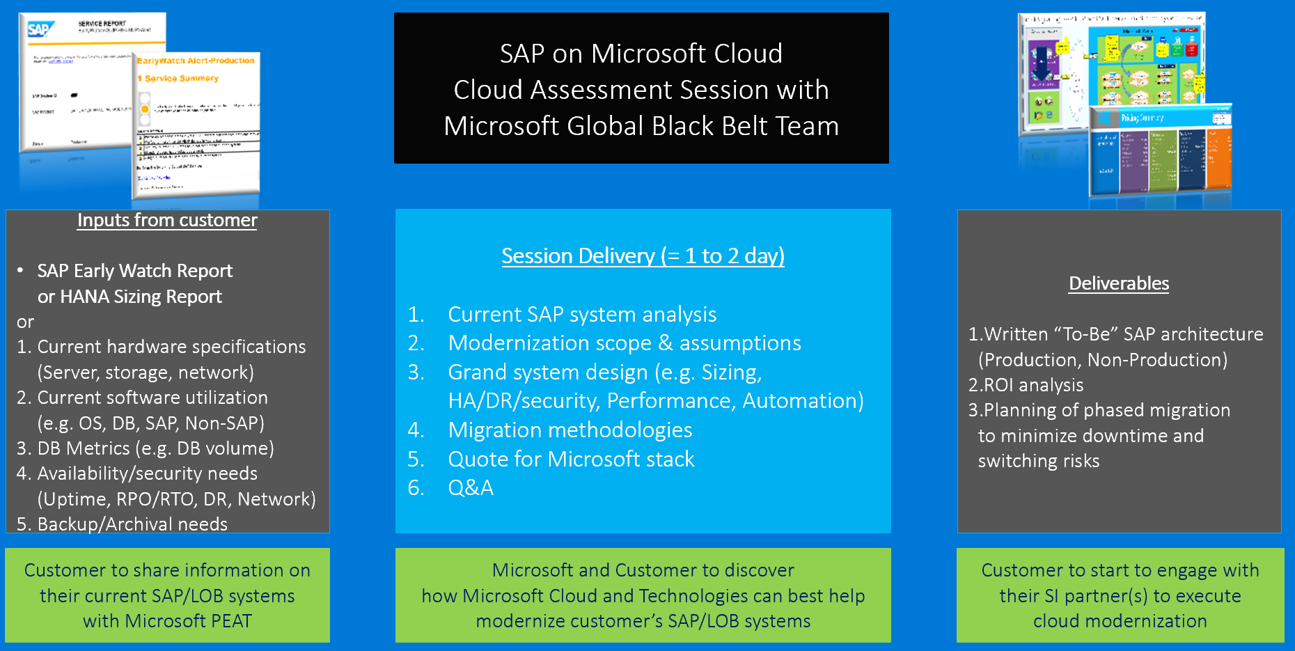
SAP on Azure - Cloud Assessment Session (= Architecture Design Session)
Notes:
Step through the process of carrying out a cloud assessment session

Slide 40
Latest SAP HANA on Azure Content
Latest SAP HANA on Azure content can be found at : https://github.com/microsoft/MCW-SAP-HANA-on-Azure/tree/master/Whiteboard%20design%20session

